Slide 1
How to Make Trade Licence
Presented by: Zita Řezáčová
Ostrava Municipality
Trade Licensing Office
June 2020

Slide 2
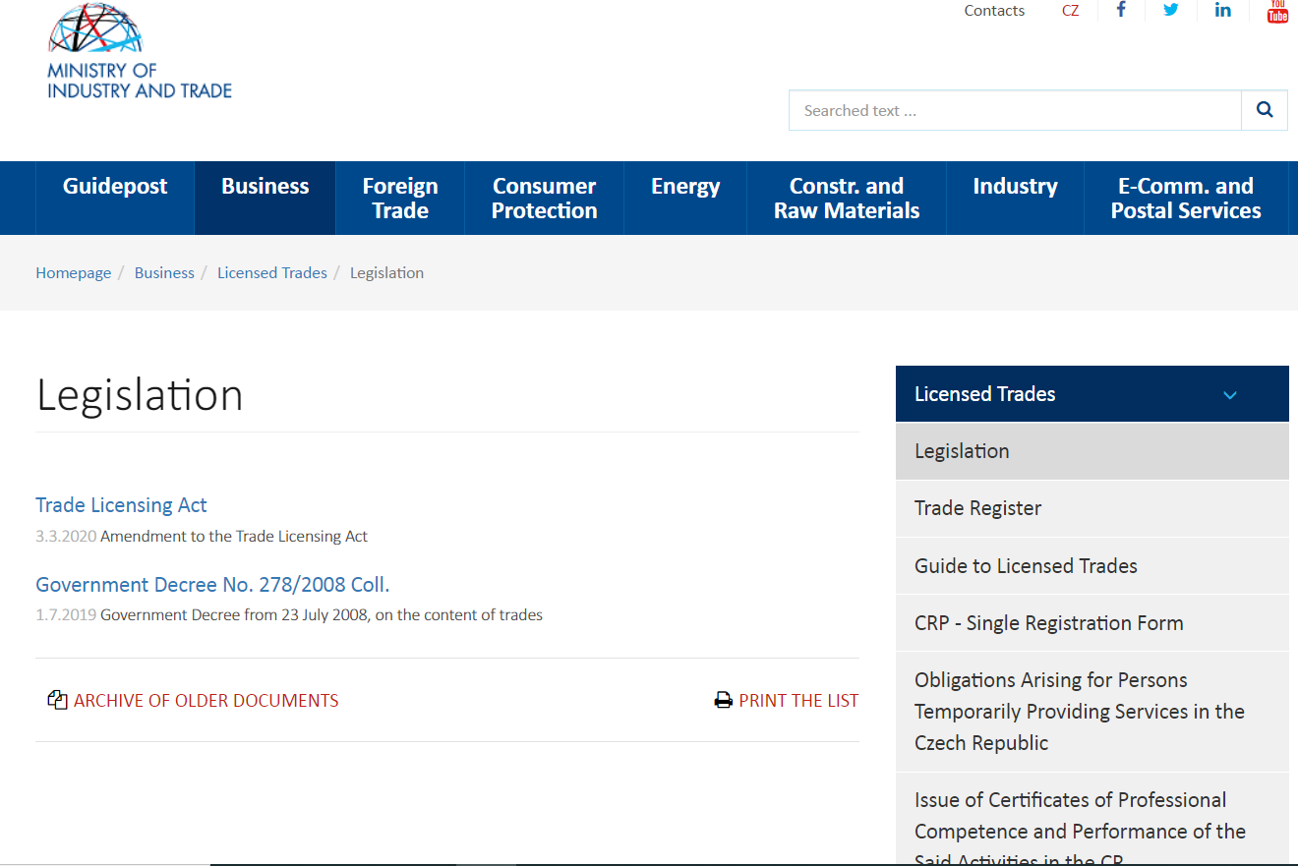
Trade Licensing Act
MPO = Ministry of Industry and Trade
Trade Licensing Act no. 455/1991 Coll.
https://www.mpo.cz/en/business/licensed-trades/legislation/

Slide 3
Živnostenský úřad Ostrava = ŽÚ
Trade Licensing Office Ostrava
Generally valid national information to help you deal with a wide range of practical issues:
Notifications, permits and documents needed to start a business
Requirements for offering services on a temporary basis

Slide 4
Trade Licensing Act: 4 Types of Trades
VOCATIONAL TRADES (crafts, e.g. Hairdressing)
= řemeslná živnost, REGULATED
PROFESSIONAL TRADES (e.g. Accounting, Real Estate Mediation)
= vázaná živnost, REGULATED
PERMITTED TRADES (Special Licences/Concessions, e.g. Road transportation)
= koncesovaná živnost, REGULATED
UNQUALIFIED TRADE (free trade, no need of professional qualifications, e.g. Teaching, Manufacturing of Textile Products, Some kinds of Consulting activities, Translations and Interpreting etc.)
= volná živnost
https://www.mpo.cz/en/business/licensed-trades/legislation/government-decree-no--278-2008-coll---83759/

Slide 5
Applicant for the Certificate of Trade Authorisation
EU citizen (+ non EU considered to be EU citizen)
Non EU citizen (the third country citizen)
General conditions (full legal capacity and integrity)
Extract from Crime Register from home state or the state of the most recent stay (only for those having no temporary residence in CZ) not older than 3 months
Professional qualification
(if required)
Permission for the Place of business (The Seat) signed by the owner/s
General conditions (full legal capacity and integrity)
Extract from Crime Register of home state (+ apostille or superlegalization if required) not older than 3 months
Professional qualification
(if required)
Long-term visa (not obligatory)
Permission for the Place of business (the Seat) signed by the owner/s

Slide 6
Applicants from non-EU countries considered to be EU applicants (§ 70)
a family member of a citizen of EU or EEA or Switzerland
a person with permanent residence in CZ (is considered to be the Czech citizen, not a foreigner) and his/her family
Non-EU citizen with the legal status of a long-term resident of CZ, or another EU state
Non-EU citizen with the granted residence in CZ or another EU country for the purpose of scientific research, studies, training or voluntary service
a family member of a person referred to in III. or IV. with long-term residence in CZ
Non-EU citizen who is a victim of trafficking or similar if has been granted residence in CZ or another EU state
the holder of a European Union Blue Card

Slide 7
Notification of the Regulated Trade
Special conditions (professional competence):
§ 21 and § 22 of the Act (vocational)
§ 24, Annex no. 2 of the Act (professional)
§ 26, § 27, Annex no. 3 of the Act (permitted)
Professional Competence may be fulfilled by a responsible representative appointed by an Applicant.

Slide 8
Responsible Representative
Must fulfill the same general conditions (§ 6):
minimum age of 18 and a clean criminal record
No restrictions on carrying on the trade (§ 8)
Must prove his/her professional competence (§ 7) by submitting the original of the document, or an officially certified copy of it to the Trade Licensing Office
Must sign the declaration that s/he agrees to this appointment; the signature on the Declaration must be officially certified unless signed in person directly at the Trade Licensing Office.
No person may be appointed as the responsible representative for more than four entrepreneurs.

Slide 9
Language of the Documents
All documents, if not drafted in the Czech language,
shall be translated.
The official certified translation to the Czech language is required only for non-EU countries.
EU countries can submit a non-official translation.
Slovak documents do not have to be translated at all.
Certified “Rubber Stamped“ Translation
(=Soudní překlad)
The Translator/ Interpreter has
the authorisation/certification
by the Court of Justice
for the particular language.

Slide 10
Non EU Applicant Without the Long Term Permit to Stay
If a non-EU Applicant meets all the requirements for notifying a trade except the long-term permit to stay in CZ, s/he will receive the Extract from the Trade Registry for the purpose of the residence permit procedure.
Later on, the Applicant is obliged to submit (§ 5 of Act No. 455/1991 Coll.) visa for a stay of more than 90 days or a long-term residence permit to the Trade License Office where the trade was registered within 3 working days from its issuing by the Foreign Police (§ 93 of Act No. 326/1999 Coll.), but no later than 6 months from the issuing the Extract from the Trade Register.
Should the applicant fail to submit a document confirming his/her residence permission in the stated deadlines, the Trade Licensing Office will decide that the Applicant has not fulfilled the conditions for the Trade Authorisation Commencement (§ 47 par. 8 of the Trade Licensing Act).

Slide 11
Non EU Citizens With Visa
Trade authorization is issued for the length of the permitted stay
Before the end of the specific period the enterpreneur MUST ASK the Trade License Office FOR the prolongation and submit a new residence permit issued by the Foreign Police.
If she/he doesn‘t have a new residence permit yet, the Trade Licese Office shall call upon that person to do so and set a reasonable time period for doing so. If the permit is not submitted within the period set on the call, the Trade Authorisation will be terminated on the last day of the period set.

Slide 12
How to Apply for the Trade Authorisation (=oprávnění)
Step by step Guide to Licensed Trades with all
the details can be found and downloaded here: https://www.mpo.cz/en/business/licensed-trades/guide-to-licensed-trades/
Administration fees:
CZK 1,000 for the first act of notifying any number of trades at the very commencement of your trading
CZK 500 for notifying further trades later

Slide 13
Before you Go in Person to the Trade Licensing Office
Please check with us IF:
Your chosen licensed trade requires professional qualifications
You can be considered as EU or non-EU citizen
You need an extract from the Crime Register
if so, check whether you need an Apostille or Superlegalization
You need visa / long term stay permission
EU citizens are obliged to report the place of stay to the Foreign Police of the Czech Republic within 30 days upon entering the Czech Republic if the intended stay in the CR is longer than 30 days

Slide 14
What to take with you for Notifying a Licensed Trade as a Natural Person (Fyzická osoba)
Identification card / certificate of residence / long-term permit
Filled in and signed “Permission for the Place of Business“ (Consent to the Seat) signed by the owner/s:
„Souhlas s umístěním sídla – Fyzická osoba“ https://www.ostrava.cz/cs/urad/magistrat/odbory-magistratu/zivnostensky-urad/formulare-1/souhlas-s-umistenim-sidla
If you are the of the property where you intend to have your seat, you will simply sign an Affidavit (= Declaration of Honour) that you are the only owner
Statement of the Criminal Record (if needed)
Evidence of Professional competence (if needed)

Slide 15
Notification of a Trade as a Corporation = Legal Person (according to the Act No. 90/2012 Coll., on Corporations and Cooperatives)
a document proving that the legal person has been established or founded in the form of notarial deed
Permission for the Place of Business (the Seat) signed by the owner
“Souhlas s umístěním sídla – Právnická osoba“ (= Legal Person)
For regulated trades: Declaration signed by the responsible representative + respective professional qualifications evidence
Power of Attorney if statutory body is not present in person
Detailed information: https://www.mpo.cz/en/business/licensed-trades/guide-to-licensed-trades/

Slide 16
In case of any questions please contact me: Phone number: 599 443 080, e-mail: zrezacova@ostrava.cz In person: City Council, Trade Licensing Office, door no. 118 Prokešovo náměstí 8, Ostrava, the Left Wing Entrance Press “Výdej dokumentů“ and choose Zita Řezáčová at the automatic call out system.
Thank you for your attention. Zita Řezáčová

